Slide 1
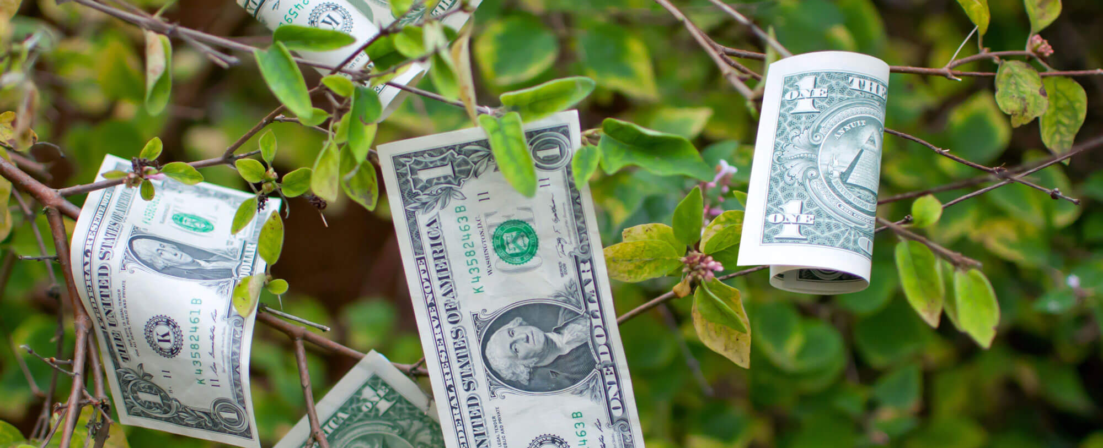
The Five Foundations
of Economics

Slide 2
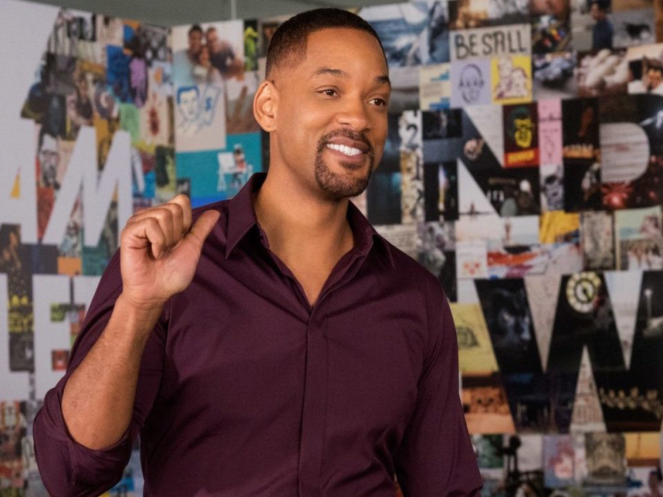
What is Economics?
What is Scarcity?

Slide 3
How many of these are scarce?
Notes:
Answer: All are scarce. None has a MC of zero.

Slide 4
Is there anything that isn’t scarce?

Slide 5
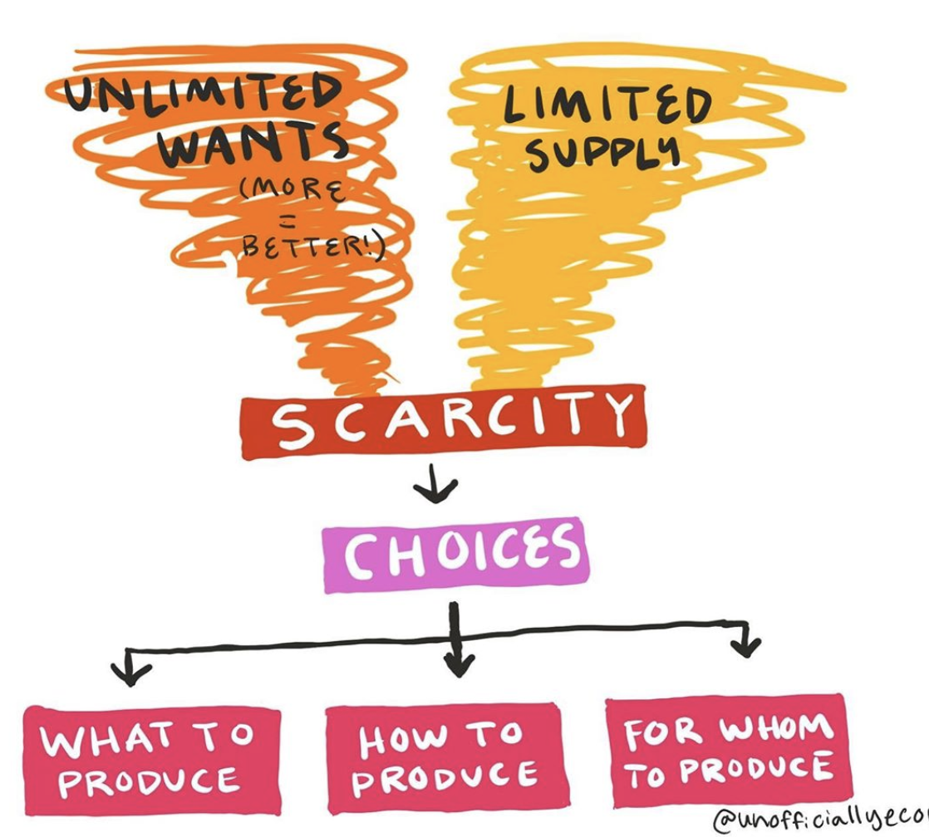

Slide 6
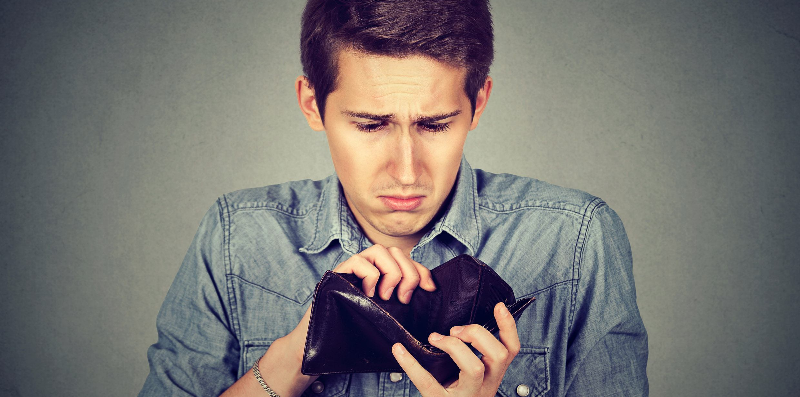
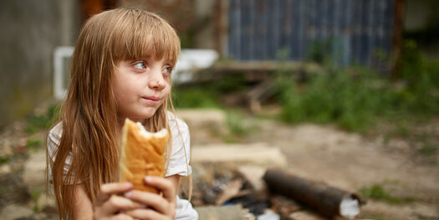
How do people allocate their limited resources to satisfy their unlimited wants?
The most important invention you’ve never heard about!
Economics helps us overcome scarcity
Global Trade Tracking

Slide 7
1
M
2
O
The Five Foundations of Economics in a mnemonic
3
T
4
I
5
V
*
E

Slide 8
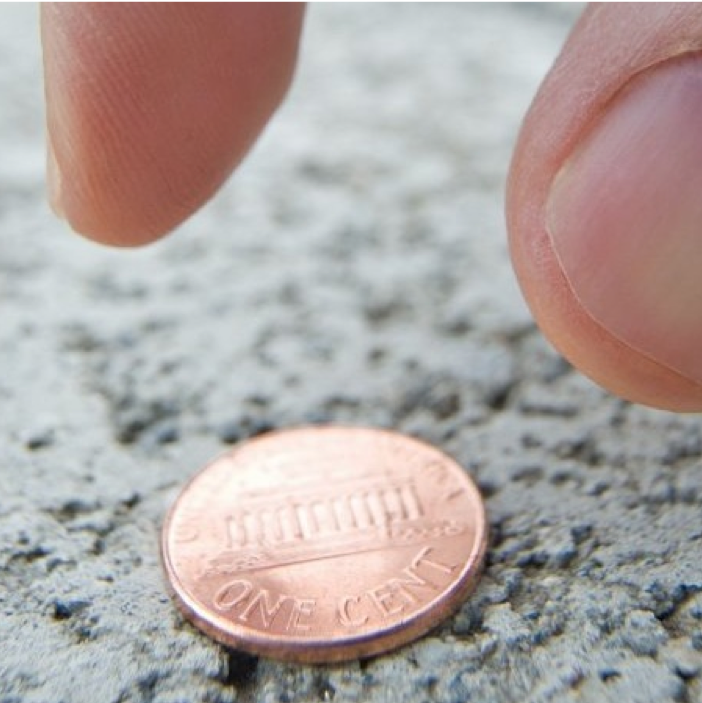
Incentives
Incentives (both positive and negative) influence our actions in _________ ways.
Foundation #1

Slide 9
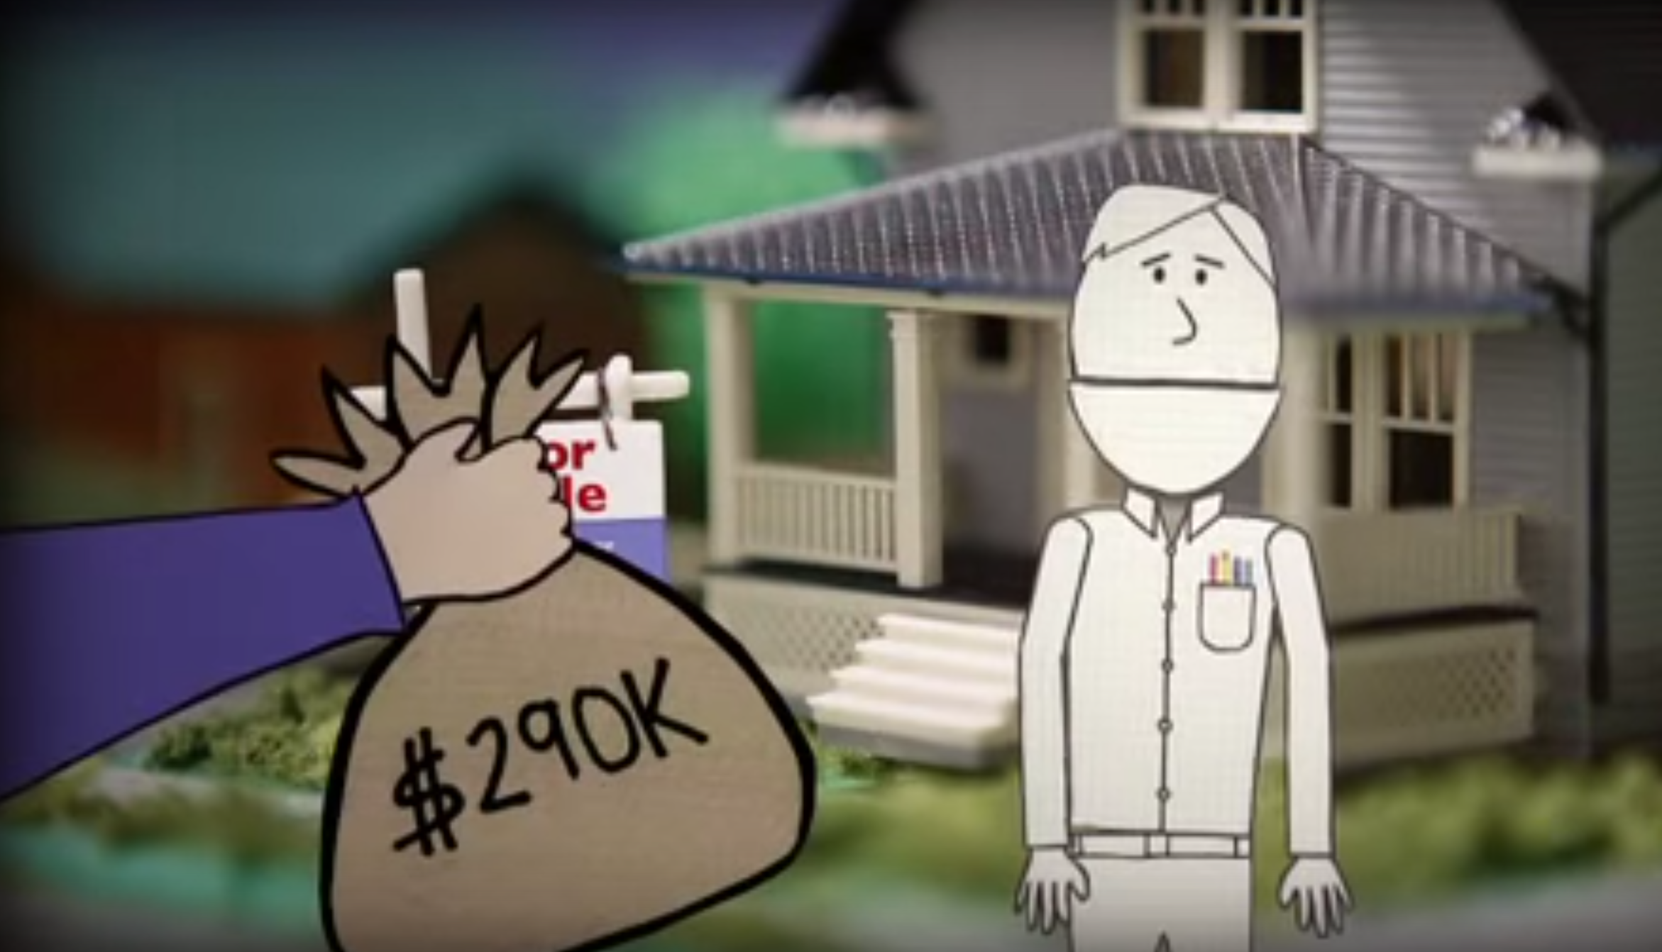
Foundation #1
Incentives
Incentives influence our actions in predicable ways but also lead to ___________ _____________.
Should you trust your real estate agent to get you the best deal?

Slide 10
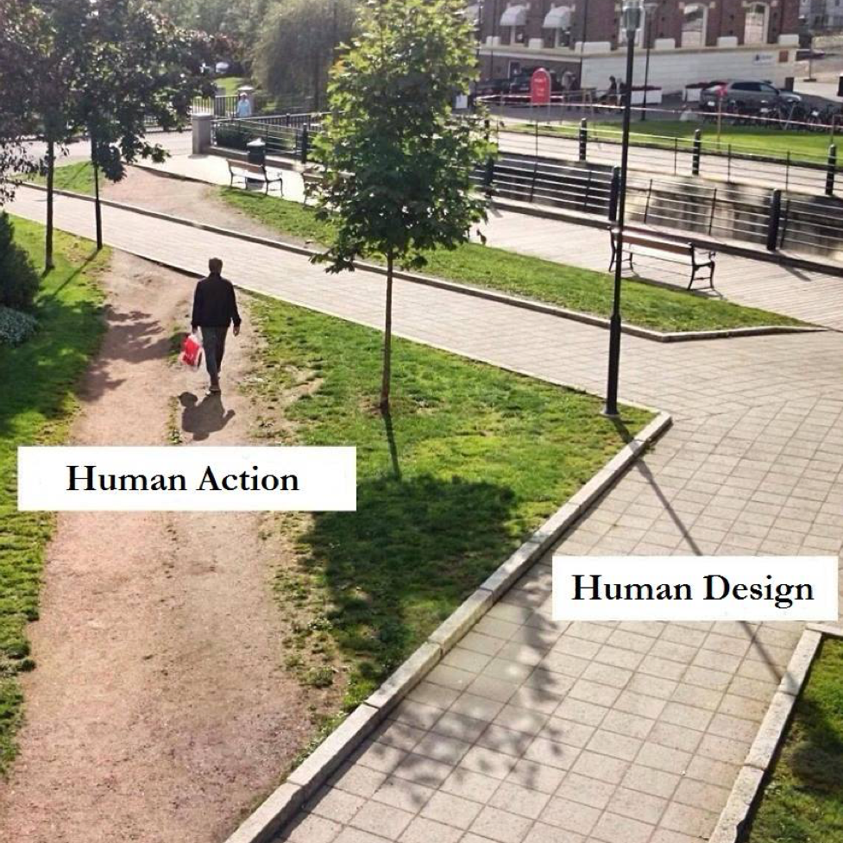
Unintended Consequences
Foundation #1: Incentives

Slide 11
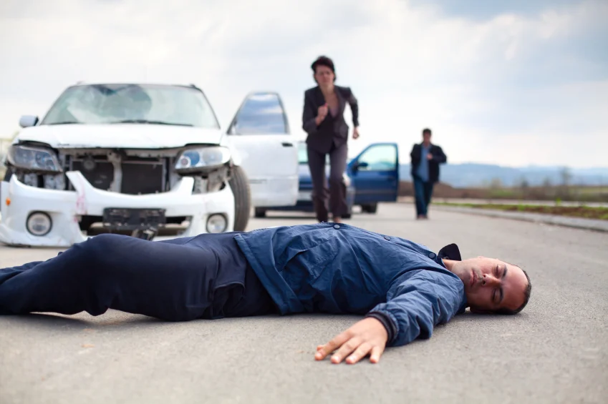
Auto Insurance Scams

Slide 12
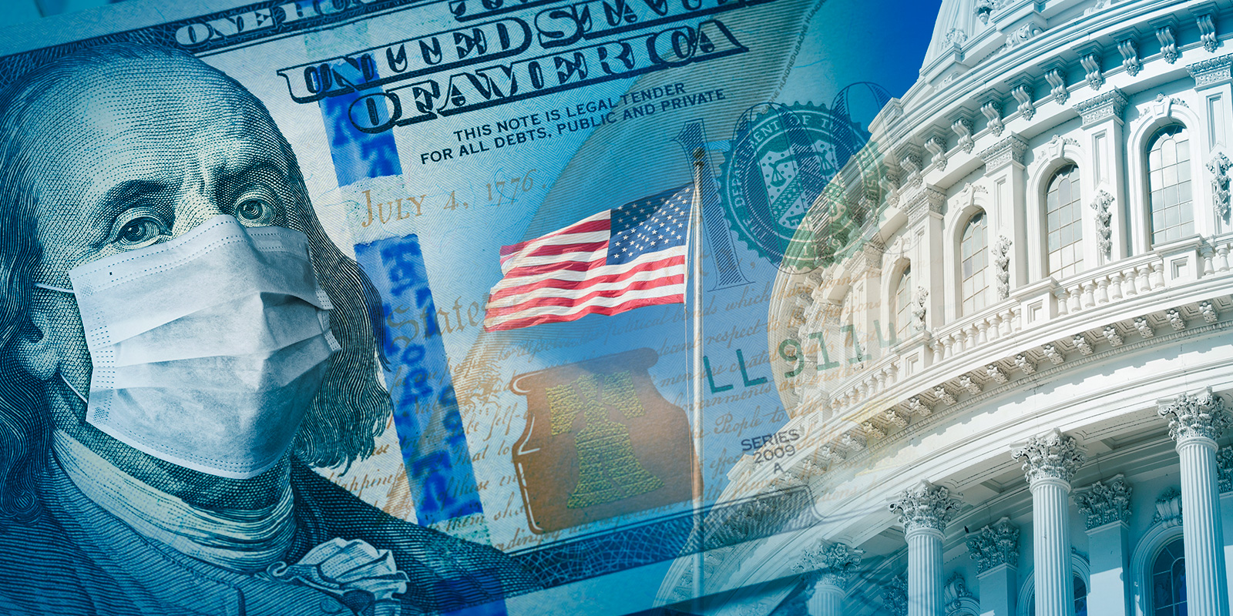
Trade-offs
Trade-offs consist of the ______ ___ of things we might have done.
Foundation #2

Slide 13
The 2.2T CARES Act Relief Question
Foundation #2: Trade-offs
Make more state-of-the art hospital beds
Write every
citizen a check
Build more fancy
NFL stadiums
Hire more K-12 teachers for 50 years
$1.5M
$6728
$5B
$3M
Make
1,466,667
beds
Write 327,000,000 checks
Hire 733,330 teachers
Build 440 stadiums

Slide 14
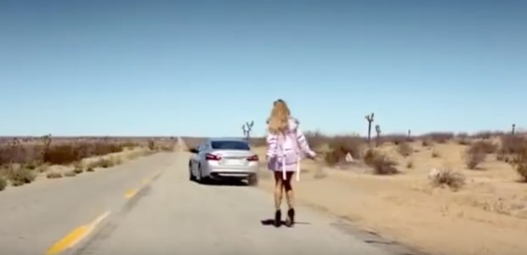
Trade-offs are a part of life
Lt

Slide 15
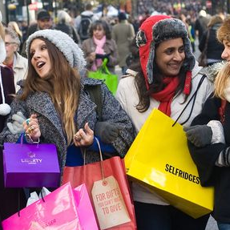
Opportunity Cost
Opportunity Cost is the _______-valued alternative that must be given up to engage in an activity.
Foundation #3

Slide 16
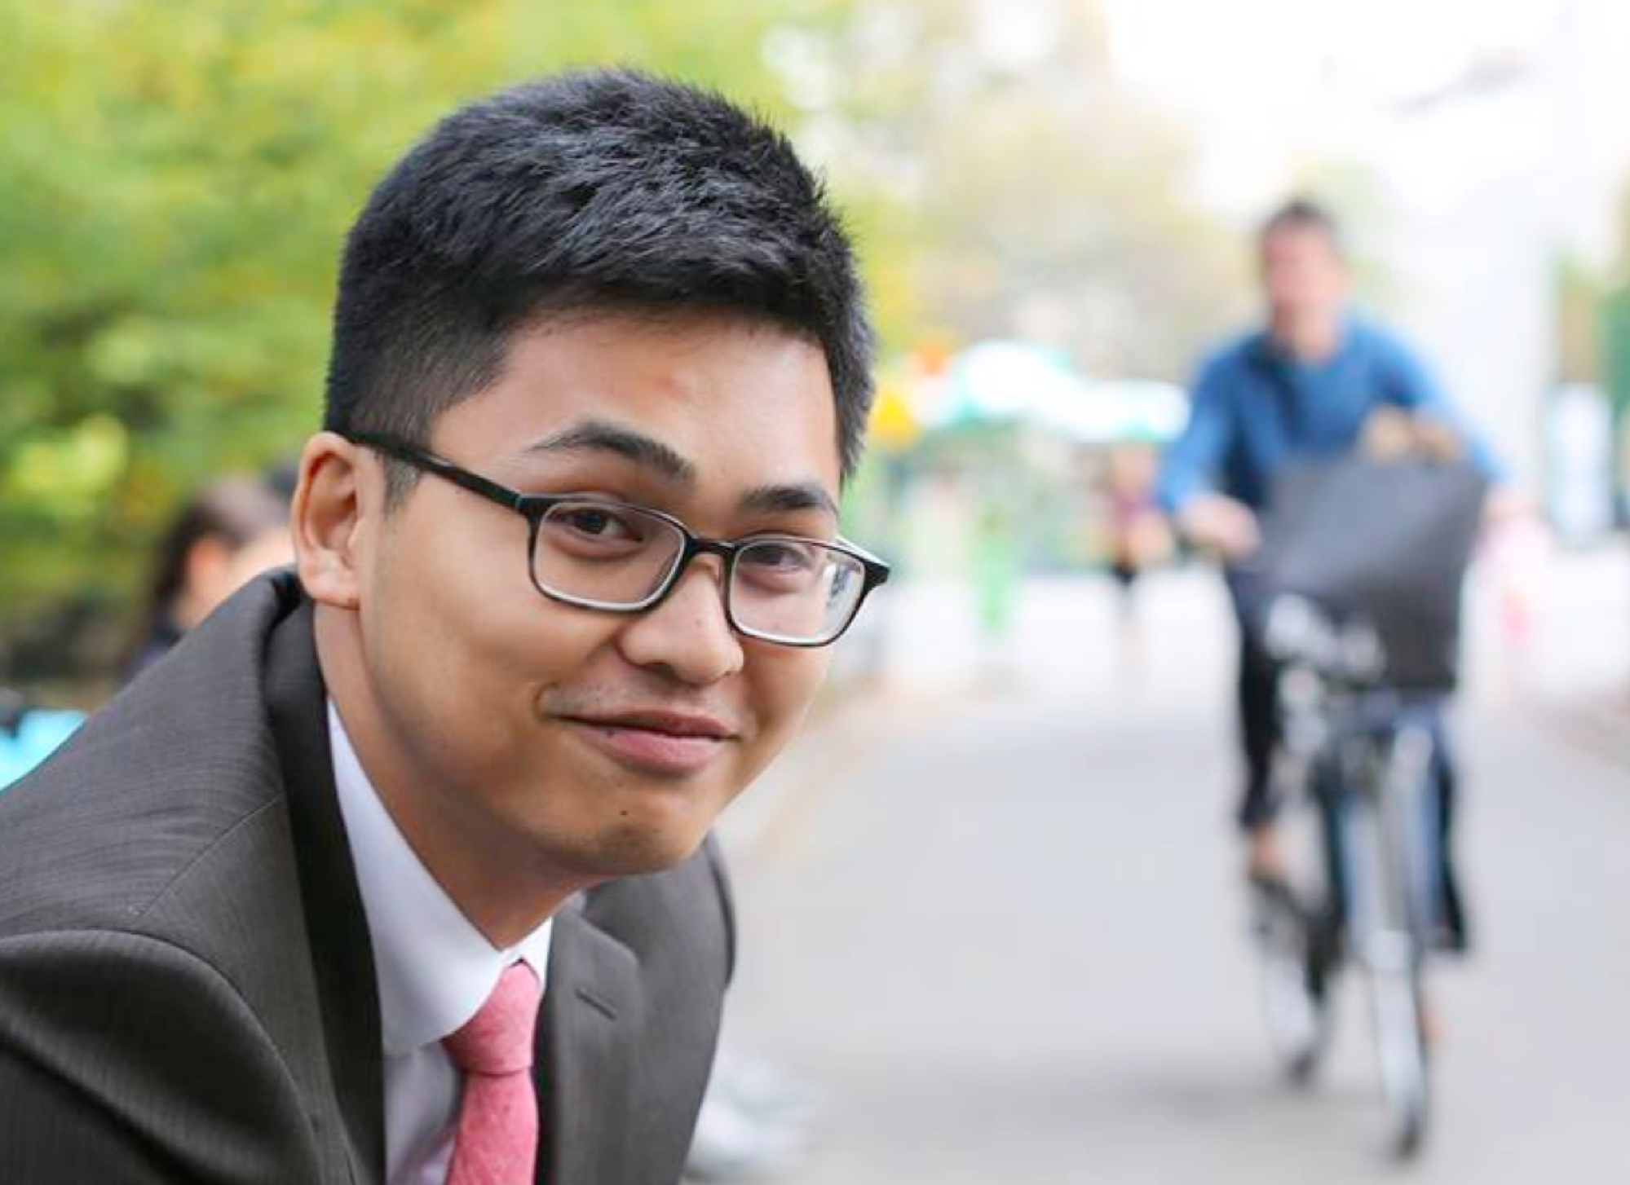
Foundation #3
Opportunity Cost
“Before medical school I was really into music. There was a girl I used to collaborate with. We did a few covers together. I went to medical school, and she skipped college and focused on music. She’s doing great now. All her songs get hundreds of thousands of views, she just got back from a tour, and signed with a record label. She stopped in New York awhile back and we met up and recorded a cover together. We just threw it together really quickly, but because of who she is now, that song got more views than the combined total of everything else I ever worked on. It’s funny how things work out.”

Slide 17
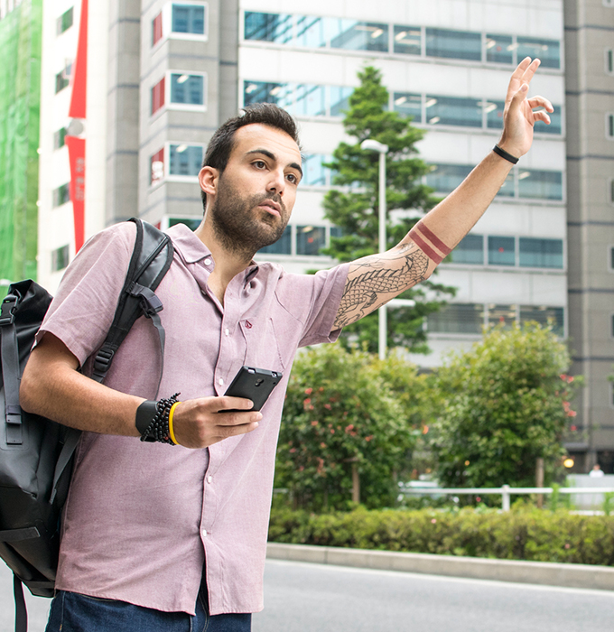
Value of Time
Foundation #3: Opportunity Cost
The value of time determines relative prices of goods and services, investments, productivity, economic growth, and measures of income inequality.

Current research suggests society is _____-valuing time improvements and subsequently _____-investing public resources in time-saving infrastructure projects and technologies.


Slide 18
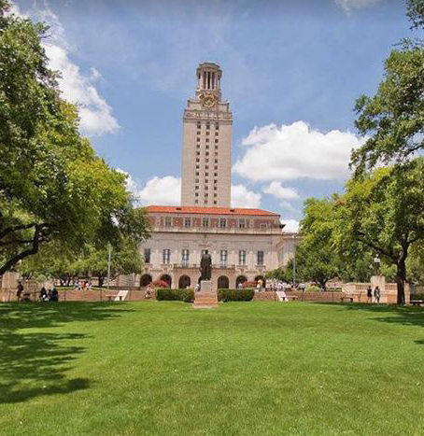
What Is the Opportunity Cost of Attending College?

Slide 19
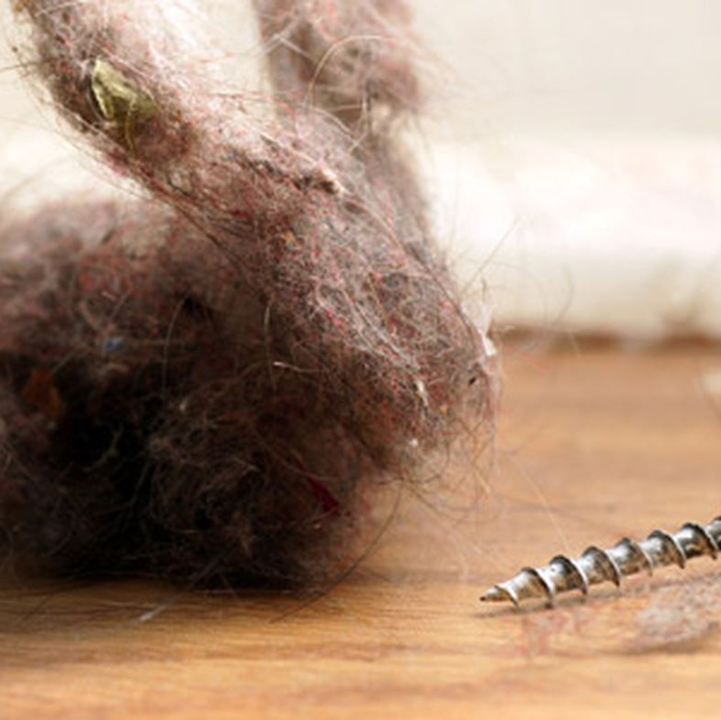
Marginal Thinking
Is the additional benefit ______ than the additional cost?
Foundation #4

Slide 20
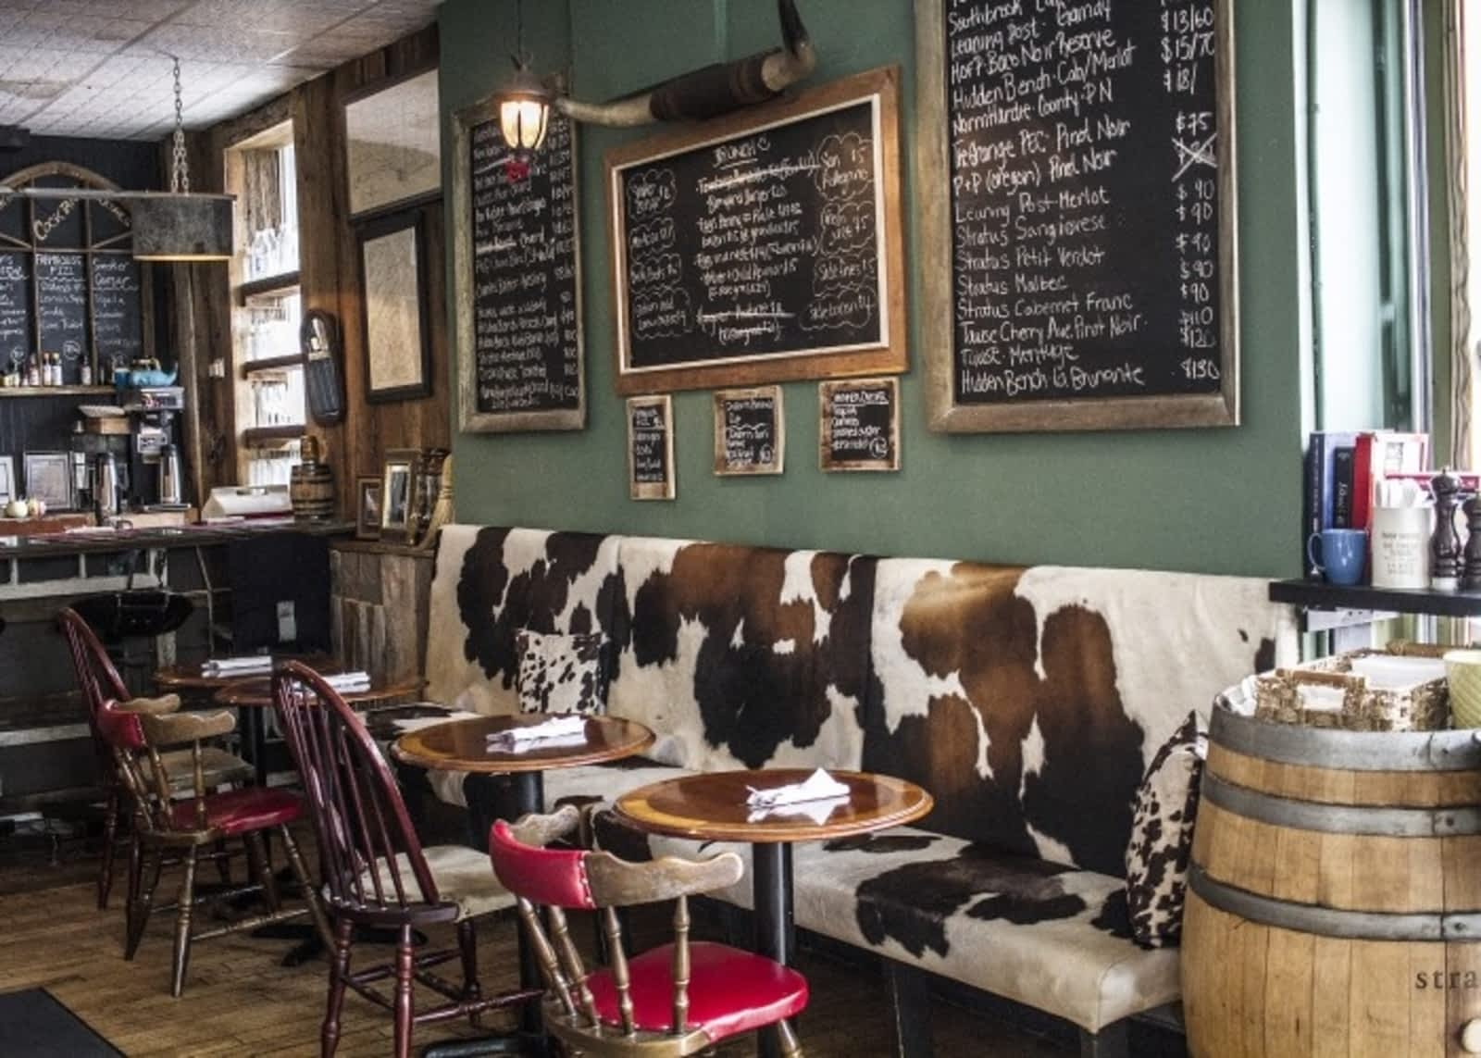
Foundation #4
Marginal Thinking
“You want to run out, but you want to make sure that you have enough of a selection, so people come back. It's a weird teeter-totter game.” - Chef Ashley MacNeil
"We start to see the good stuff going away, so we order quickly. We end up ordering more because of the specials" - a regular Sunday customer
"I hate freezing stuff, and I hate throwing food out, so we needed to find a solution that would help us use up as much as we could before closing for three days,” – owner Darcy MacDonell

Slide 21
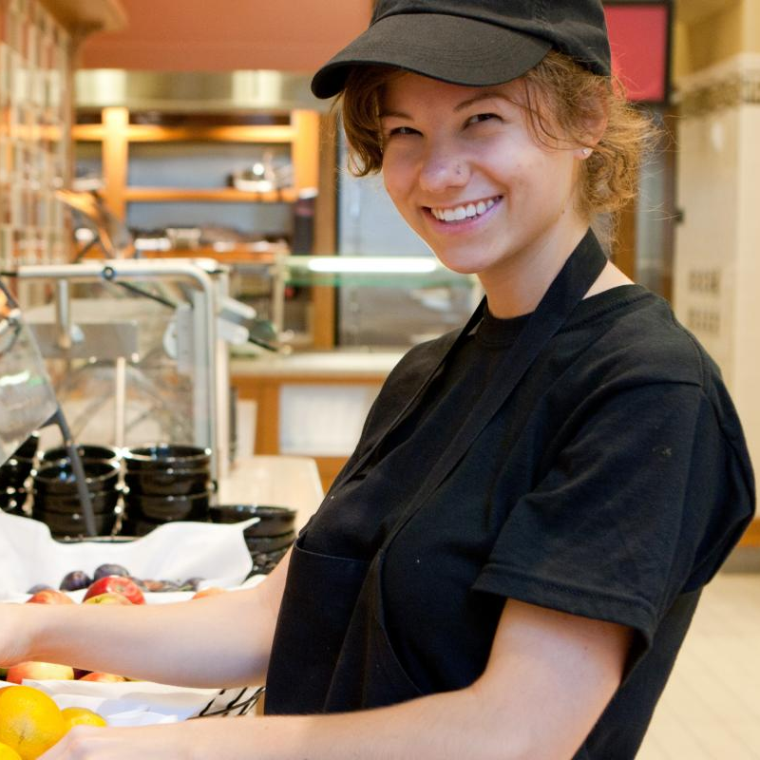
Trade
Trade _____ value and depends on __________ and __________ advantage.
Foundation #5

Slide 22
